Slide 1
MOVIE RECOMMENDATION SYSTEM USING CRISP-DM
PATRICK NJOROGE
14TH JUNE 2026

Slide 2
1. BUSINESS UNDERSTANDING
Problem Statement
Streaming platforms such as Netflix, Disney+, Amazon prime among others face a challenge: Users are overwhelmed by thousands of movie choices.
Business objectives
Build a Recommendation system that:
- Improves user engagement
- Personalizes user experience
- Increases watch time
- Reduces search effort
Success Criteria
The recommendation system will be considered successful if it achieves low RMSE and MAE values while maintaining high Precision@10 and Recall@10 scores.

Slide 3
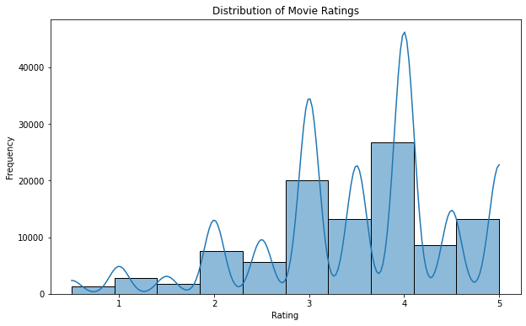
2. DATA UNDERSTANDING (EDA)
Ratings distribution histogram
Most ratings fall between 3 and 5 stars, indicating that users generally provide positive feedback.

Slide 4
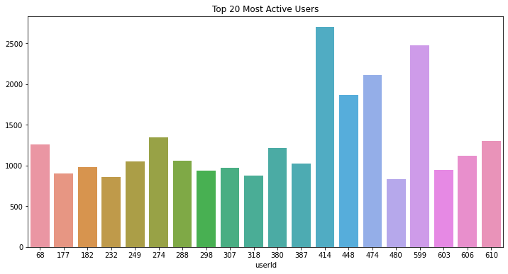
Top user leaderboard
A small number of users contribute a disproportionately large number of ratings. These users provide valuable information for recommendation algorithm.

Slide 5
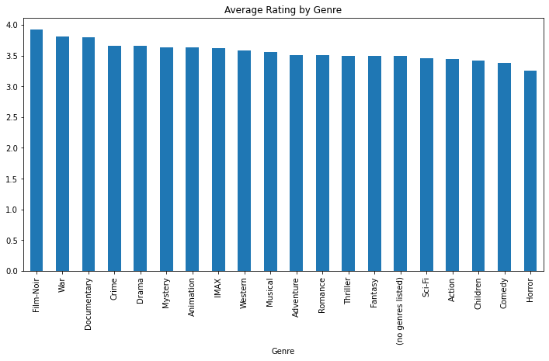
Top genres by ratings
Some genres consistently receive higher ratings, indicating stronger audience preference.

Slide 6
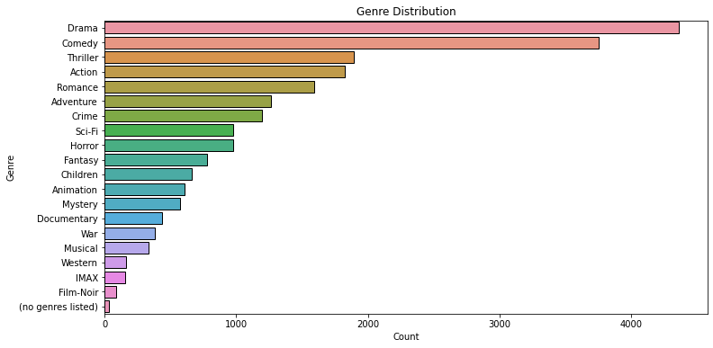
Movie genre distribution
Genres like Drama, Comedy ususally dominate MovieLens indicating huge audience. Western, IMAX, Film-Noir have a low audience hence they are not highly recommended.
Most users rate only a few movies while a small group of highly active users contributes many ratings.

Slide 7
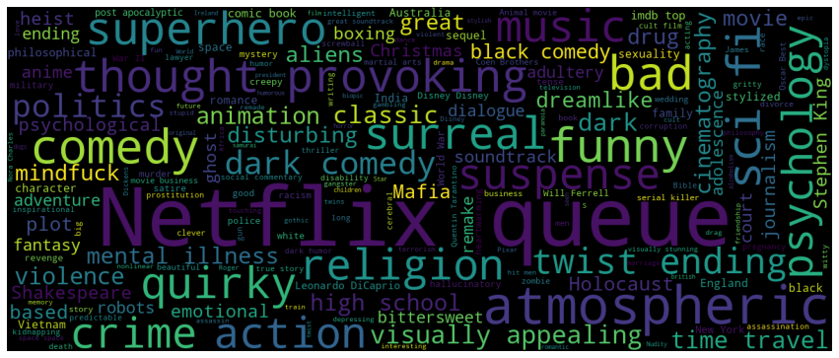
Wordcloud of Tags
Larger words = more common tags. This provides insight into user perceptions.

Slide 8
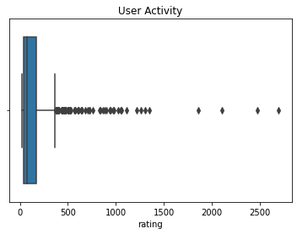
User activity distribution
median activity
Outliers This means that most users rate few movies and some users rate many.

Slide 9
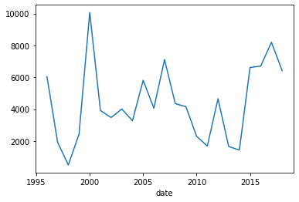
Rating timeline trends
The rating timeline trend illustrates how user engagement changed over time. An increasing number of ratings indicates growing platform activity and user participation.
This suggests that the recommendation system has access to a richer historical dataset for learning user preferences.
A decline in ratings would indicate reduced engagement and potentially less reliable recommendation performance.

Slide 10
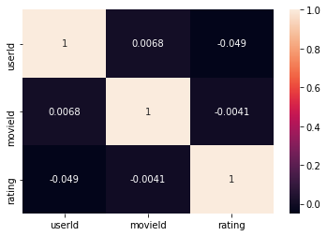
Correlation Heatmap
This shows the relationship among UserId, MovieId, and Ratings.

Slide 11
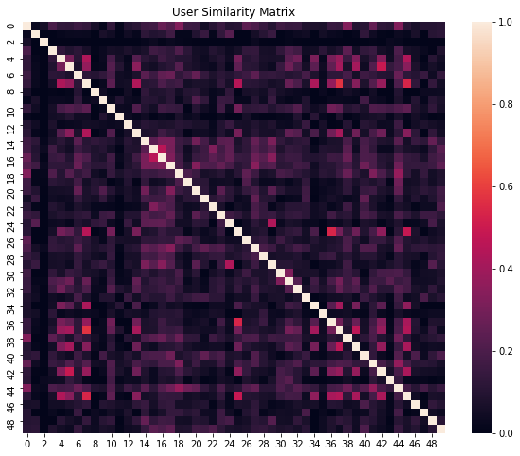
3. Modelling User-Based collaborative filtering
This shows the similarity scores between users based on their historical ratings. Darker regions represent users with highly similar movie preferences, while lighter regions indicate users with dissimilar tastes.
Presence of clusters suggests that groups of users share common interests, making user-based collaborative filtering suitable for generating personalized recommenndations.

Slide 12
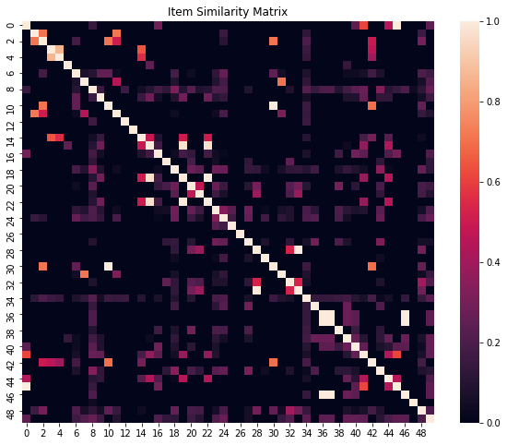
Item-Based collaborative filtering
This shows how similar movies are based on user rating behaviour. Movies with high similarity scores tend to be liked by the same users and therefore form natural recommendation clusters.
This visualization supports the use of item-based collaborative filtering because similar movies can be recommended to users who enjoyed related content.

Slide 13
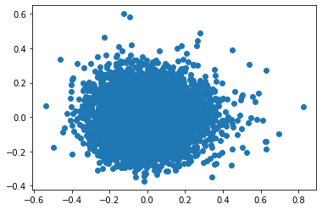
Matrix Factorization (SVD)
The PCA projection of SVD latent factors provides a two-dimensional representation of the hidden features learned by the matrix factorization model.
Movies positioned close together share similar latennt characteristics and appeal to similar user groups.
This demonstrates that SVD successfully captures underlying preference patterns that are not directly observable in movie genres or ratings alone.

Slide 14
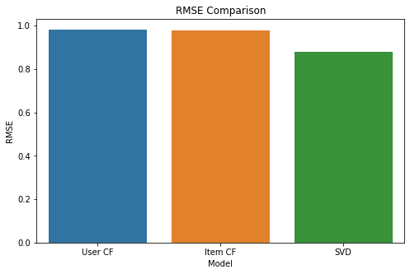
4. EVALUATION RMSE COMPARISON
On average, SVD's predictions differ from actual user ratings by approximately 0.88 rating points, while User-Based and Item-Based Collaborative Filtering differ by approximately 0.98 rating points.
SVD achieved the lowest RMSE and therefore provided the most accurate rating predictions among the evaluated models.

Slide 15
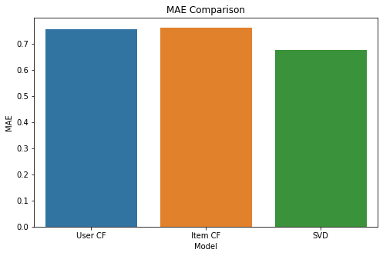
MAE Comparison
The SVD model misses the true rating by approximately 0.68 stars on average, whereas User-Based Collaborative Filtering misses by approximately 0.76 stars.
The lower MAE obtained by SVD confirms that it consistently produces more accurate predictions than the collaborative filtering approaches.

Slide 16
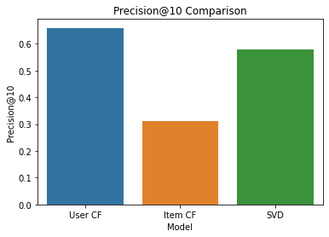
Precision@10 Comparison
In user CF Approximately 66% of the movies recommended by the User-Based Collaborative Filtering model are relevant. About 6–7 movies out of every 10 recommendations are relevant.
In SVD, Approximately 59% of the recommended movies are relevant. About 6 out of every 10 recommendations are relevant.
In Item CF, Only about 31% of recommended movies are relevant. Roughly 3 out of every 10 recommendations are useful.
Although SVD had the best RMSE and MAE, User CF achieved the highest Precision@10.
This means:
User-Based Collaborative Filtering is better at placing relevant movies in the recommendation list, even though SVD predicts ratings more accurately overall.

Slide 17
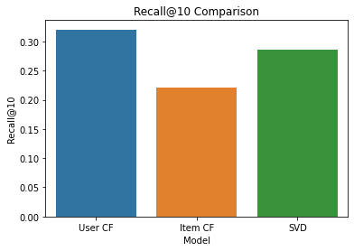
Recall@10 Comparison
Recall@10 measures:
How many of all relevant movies were successfully retrieved by the recommender
The SVD model successfully retrieved approximately 28% of all relevant movies available for users.
The recall is lower than Precision is because a Recommender can:
Recommend only highly confident movies
Precision increases
Recall decreases

Slide 18
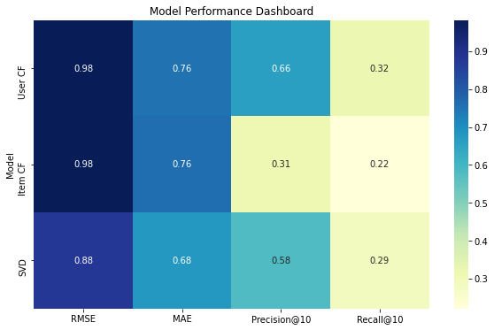
Model performance dashboard
This performance dashboard provides consolidated comparisons of all recommendation models.
It enables direct identification of the strongest model by simultaniously examining prediction accuracy and recommendation quality.
This shows that SVD consistently achieves lower prediction errors while maintaining competitive recommendation relevance, making it the most balanced model for deployment.

Slide 19
CONCLUSION
EDA revealed that user ratings are generally positive, with most ratings concentrated between 3 and 5 stars.
User-item interaction matrix was highly sparse, indicating that users rate only a small fraction of the available movies, which is a common challenge in recommendation systems.
Popularity-based recommendations provide simple recommendations based on highly rated and frequently rated movies but lacked personalization.
Content-based filtering successfully recommended movies with similar genres but was limited with available movie metadata.
User-based and Item-based collaborative filtering leveraged historical rating behaviour to generate personalized recommendations.
SVD achieved the best prediction performance with an RMSE of 0.88 and MAE of 0.67, indicating the lowest prediction errors among evaluated models.
User-based collaborative filtering achieved higher precision@10 (0.65) demonstrating strong recommendation quality.
Based on overall evaluation resaults, SVD was selected as the most suitable recommendation model for deployment.

Slide 20
RECOMMENDATIONS
Deploy the SVD recommendation model as the primary recommendation engine because it achieved the best overall performance across RMSE,MAE,Precision@10 and Recall.
Develop a hybrid recommendation system that combines SVD and Content-based filtering to improve recommendation quality.
Periodically retrain the recommendation model using newly collected rating to ensure recommendations remain relevant and adapt to changing user preference

